Slide 1
moocs
Department of Computer Applications
National Institute of Technology Kurukshetra
Ankur Gupta(5141083)
Mukesh Verma(5141085)
Vivek Lambhi (5141087)
Supervisor : Dr. Kapil Gupta

Slide 2
outline
INTRODUCTION
LITERATURE SURVEY
GAPS IDENTIFIED
COMPARATIVE STUDY
NEED OF THE SYSTEM
PROPOSAL
TOOLS & TECHNIQUES
DESIGN & IMPLEMENTATION
FEATURES
CONCLUSION
FUTURE SCOPE
REFERENCES

Slide 3
Moocs (Massive Open Online Courses)
MOOCs: So Many Learners, So Much Potential ...

Slide 4
introduction
MOOCs is a one way of learning.
A course of study made available over the Internet with or without charge to a very large number of people.
It is an event of courses which is open access.
Open access means access it from anywhere, everywhere.
It is a way to connect and collaborate skills.

Slide 5
Table: Comparison of key aspects of MOOCs or Open Education initiatives
Ref[3]
Initiatives | For profit | Free to access | Certification fee | Institutional credits
eDX | X | ✓ | ✓ | X
Coursera | ✓ | ✓ | ✓ | X✓
Udacity | ✓ | ✓ | ✓ | X✓
Udemy | ✓ | X✓ | ✓ | X✓
P2PU | X | ✓ | X | X
Key:
X Not a feature
✓ Feature present
X✓ Features partially present

Slide 6
Table : Key features for artificial intelligence in education (AIED), across a sample of major massive open online course (MOOC) platforms.
Ref[4]
Features | eDX | Coursera | Google Course | Class2Go | Udemy | Lernanta
Video lectures
Where are they stored? | YouTube | Coursera | YouTube | YouTube and Amazon S3 | Udemy or YouTube | N/A
Quizzes integrated with video | No | Yes | No | Yes | No | N/A
Discussion on video page? | Yes | No | No | No | Yes | N/A
Additional files and features | Subtitles | Subtitles files | Subtitles files | Subtitles | Subtitles video and slide mashup | N/A

Slide 7
 | eDX | Coursera | Google course | Class2Go | Udemy | lernanta
Quizzes
Are there quizzes outside of videos? | Yes | Yes | Yes | Yes | No | N/A
Question types
Multiple choice | ✔ | ✔ | ✔ | ✔
Short answer | ✔ | ✔ | ✔ |  |  | ✔
Numeric |  |  |  | ✔
No. of attempts allowed | Limited | Limited | Unlimited | Limited | N/A | N/A
Ref[4]

Slide 8
Ref[4]
 | eDX | Coursera | Google Course | Class2Go | Udemy | lernanta
Discussion forums
Can posts be rated? | Positive | Positive/negative | N/A | None | None | None
Grading and analytics
Student’s view of progress | Raw marks with graph | Raw marks | None | Raw Marks | Progress percentage | Progress percentag
Teacher’s view of progress | Unknown | Unknown | CSV* export Google analytics (CSV) | Multiple types of detailed CSV reports | N/A | Can see and edit progress

Slide 9
Research Gaps
Boundary Condition :
In research papers boundary condition has been mentioned i.e. if the users violates the boundary condition they have given then the user will not be able to access the services.
Cost :
This is one of the main research gap we have found i.e. many of the existing systems that have been proposed yet required additional hardware.
Privacy :
The existing systems are less secure because they do not provide authentication like before connecting to system you need permission for accessing his account .

Slide 10
Need of the system
Rapid growth in the education field resulting in increasing the challenges in our daily life.
Some of such challenges include multiple subject exercise,cost,security etc.
Our system will be very useful for the people in their day to day life .
This system will overcome the research gaps we have mentioned before.

Slide 11
proposal
MOOCs based mobile application:
A mobile application that will provide a system of learning through web media.
Application will provide a platform to the user where user can discuss their problems and solutions, submission of assignments and also they will get hints regarding their problems.

Slide 12
Tools:-
Eclipse.
Java.
Android sdk.
Xml.
SQLlite.

Slide 13
Design and Implementation

Slide 14
Username and password
Block Diagram
Select the subject you want to learn
Select exercise
if ans is right
No
Get hints or discuss with others
Yes
Submit answer & switch next question
Stop

Slide 15
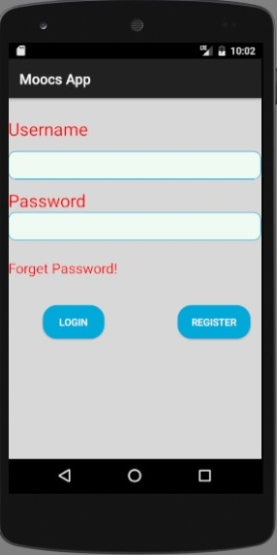
This is how the login window look like.

Slide 16
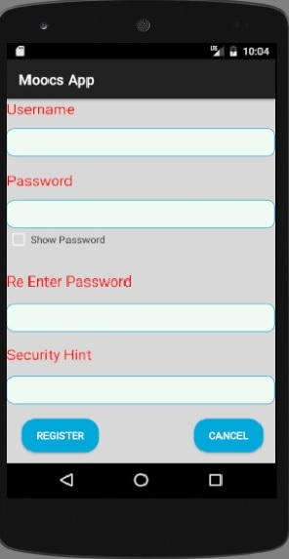
This is how the registration window look like having an extra feature-security hint.

Slide 17
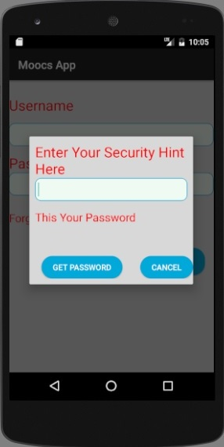
This is security hint pop window, if the user forgot password then he/she have to type the security hint to get the password.

Slide 18
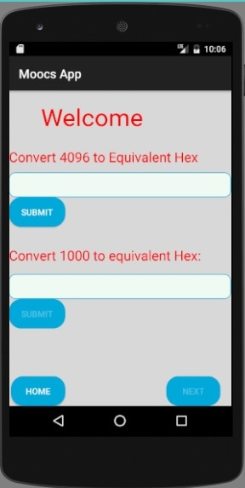
This is the welcome window having exercise questions.

Slide 19
Features
Users will be able to connect through application as well as website.
Adding more functionalities like :-
Practice exercise
Discussion forum.
Online access.

Slide 20
Conclusion
With our propose system, a successful attempt is made to reduce both initial investment cost as well as the operational cost in terms devices an services. There is no need for someone to buy other expensive service.
Using the free online website service for learning , there is no need to go for a paid services and this contributed in the cost reduction of developing the system.

Slide 21
Future Scope
With the help of a server a successful application can be developed through which all the mentioned objective can be achieved.

Slide 22
References
Ref[1]: Anderson, T., & McGreal, R. (2012). Disruptive pedagogies and technologies in universities. Education, Technology and Society, 15(4), 380-389.
Ref[2]: Liyanagunawardena, Tharindu Rekha, Andrew Alexandar Adams, and Shirley Ann Williams. "MOOCs: A systematic study of the published literature 2008-2012." The International Review of Research in Open and Distributed Learning14.3 (2013): 202-227.
Ref[3]: Yuan, Li, Stephen Powell, and JISC CETIS. "MOOCs and open education: Implications for higher education." (2013).
Ref[4]: Kay, Judy, et al. "MOOCs: So Many Learners, So Much Potential..." IEEE Intelligent Systems 3 (2013): 70-77.

Slide 23
Thank you

